Slide 1
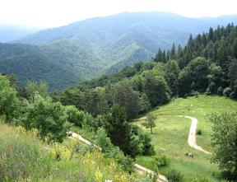
SUMMER SCHOOL 2013
Associations

Slide 2
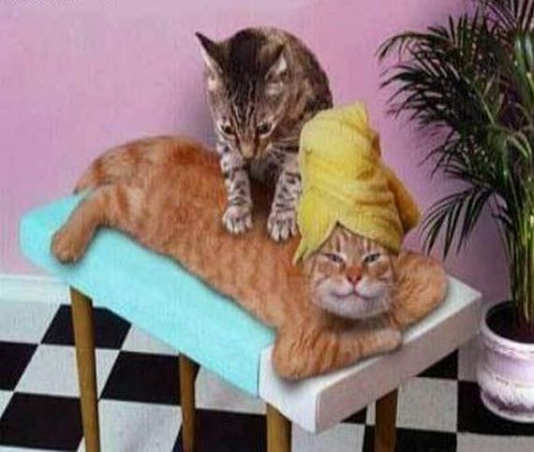
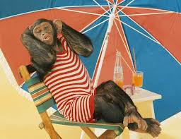
Our expectations…

Slide 3
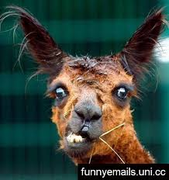
I felt …
Day 1

Slide 4
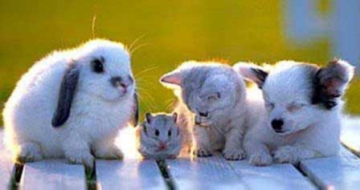
Friendly atmosphere

Slide 5
BRAINSTORMING

Slide 7
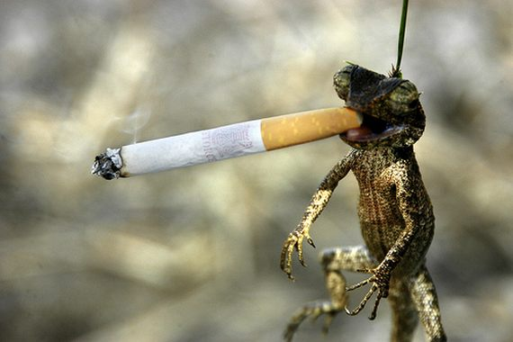
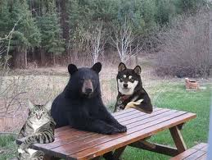
BREAKS

Slide 8
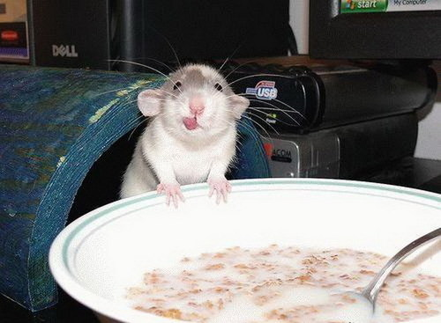
LUNCH – Group 2

Slide 9
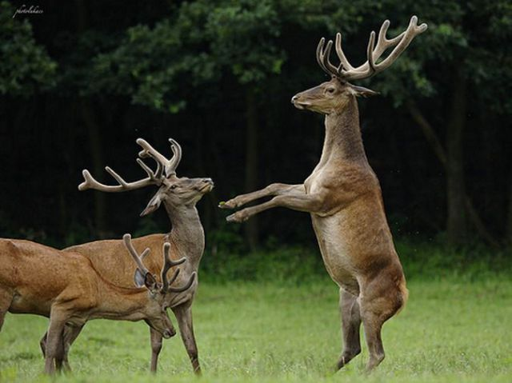
TRAIN THE TRAINER

Slide 10
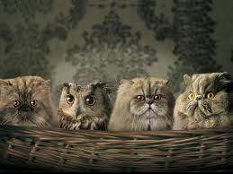
OBSERVERS
I SAW…
I FELT…

Slide 11
INDIVIDUAL
WORK

Slide 12
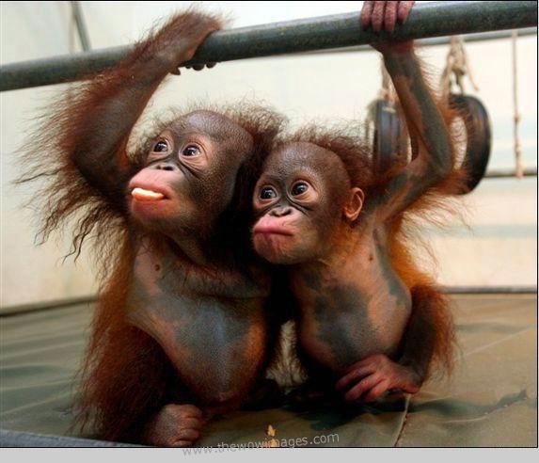
PAIR WORK

Slide 13
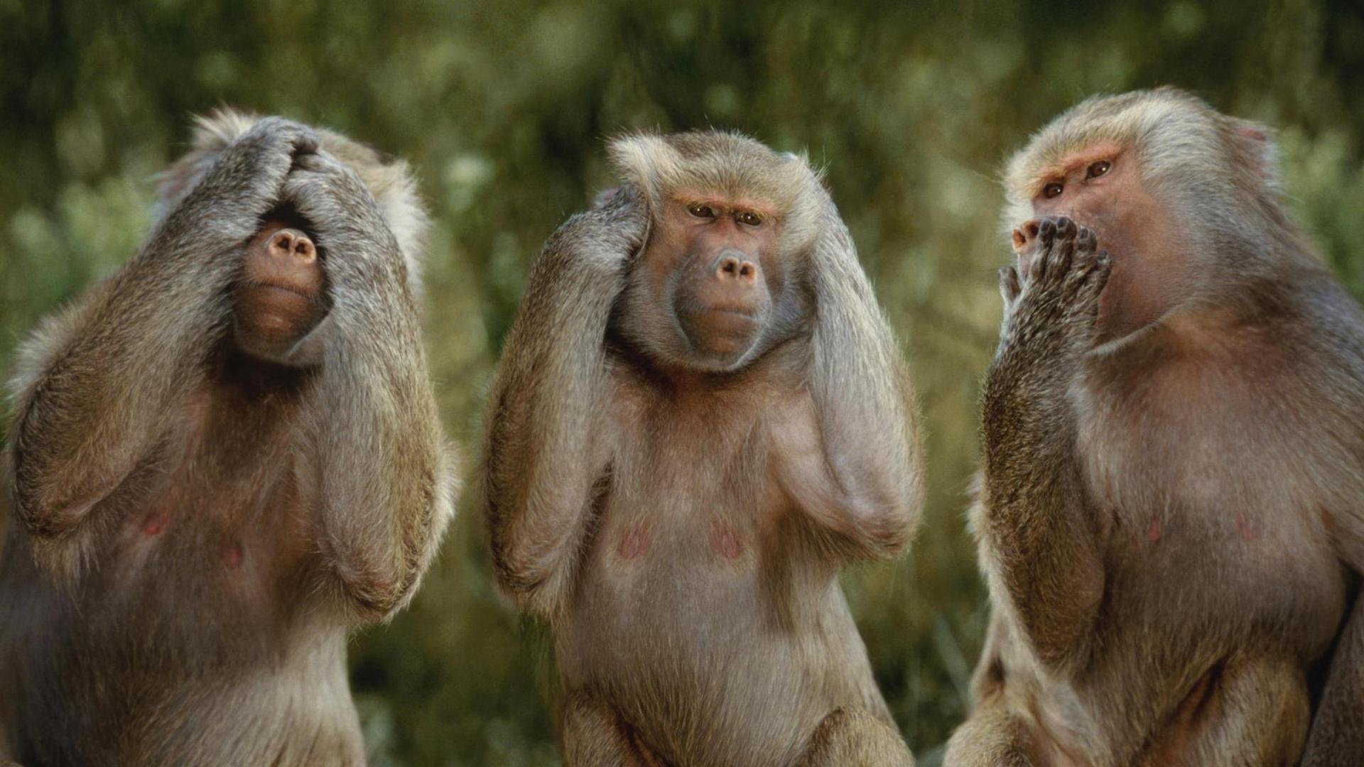
GROUP WORK

Slide 14
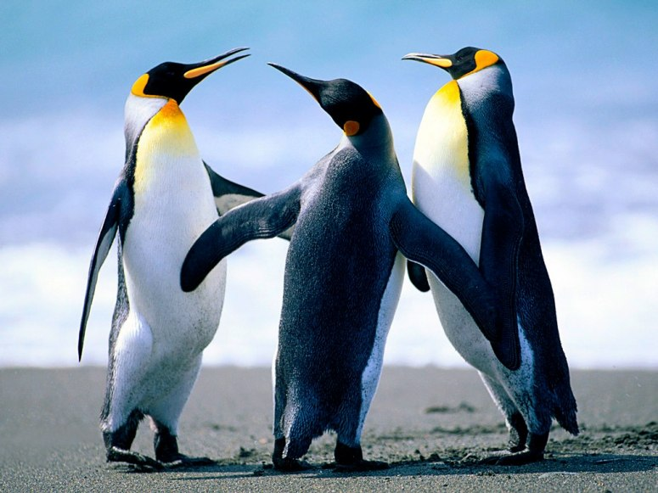
DISCUSSION

Slide 15
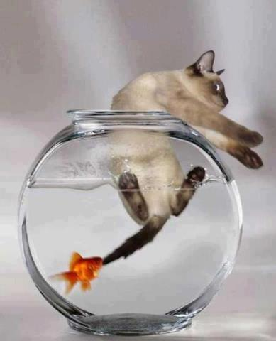
FISHING
FOR
IDEAS

Slide 16
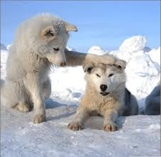
PEER SUPPORT

Slide 17
BEFORE MICRO-
TRAINING

Slide 18
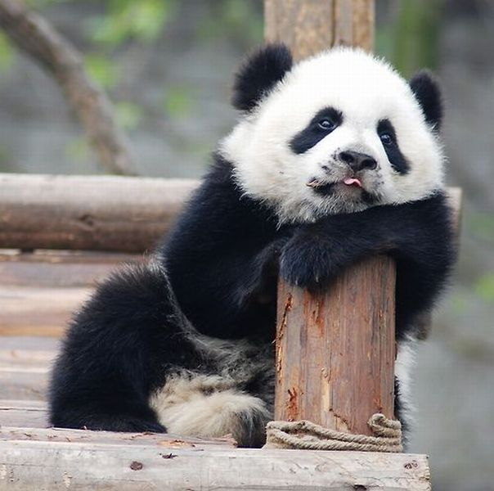
AFTER MICRO-
TRAINING

Slide 19
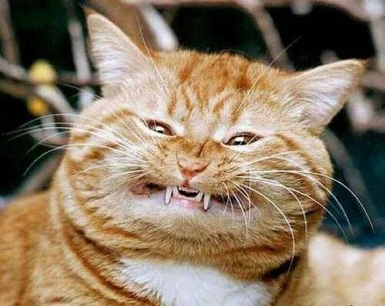
NEGATIVE/DISTRUCTIVE Feedback
UNHELPFUL

Slide 20
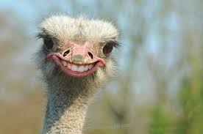
Too positive feedback

Slide 21
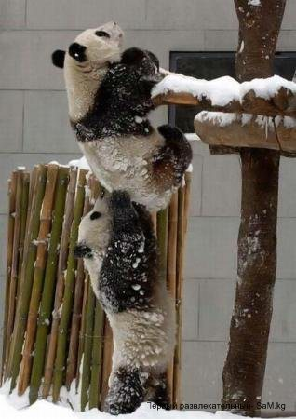
POSITIVE/
CONSTRUCTIVE FEEDBACK

Slide 22
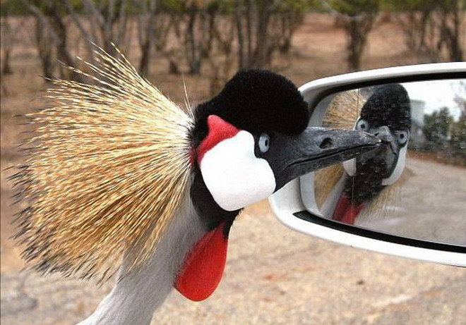
Self-reflection

Slide 23
ROUND UP DISCUSSION

Slide 24
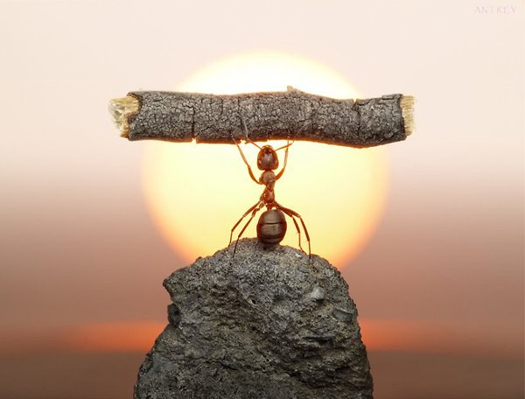
THE MODEL OF THE TRAINER

Slide 25
CATALYST FOR CHANGE
AND DEVELOPMENT

